Slide 1
DROP DB – simple event sourcing for simple aliens

Slide 2
DROP DB
Is the life without database possible?
Come and see what might happen if You do not have database and the power goes down. What if the system needs to be restarted?
What about concurrency and performance?

Slide 3



Software stack

Slide 5
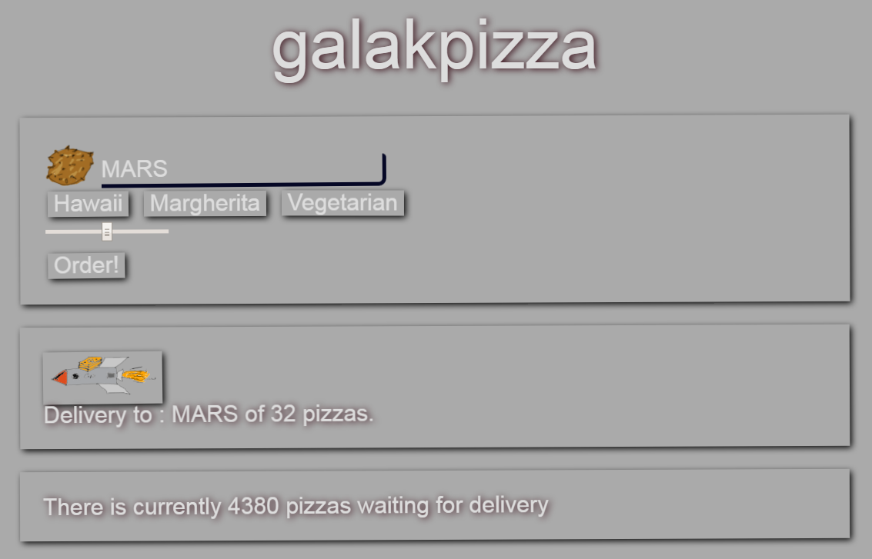

Slide 6
Place order
placeOrder() { var headers = new Headers(); headers.append('Content-Type', 'application/json'); var options = new RequestOptions({ headers: headers }); console.info("ordering:" + this.size+" @ " + this.variant+ " on" + this.planet); this.http.post("/services/order", JSON.stringify({ "planet" : this.planet, "variant" : this.variant, "size": "XL"} ), options) .subscribe(res => console.log("got:" + res)); }

Slide 7
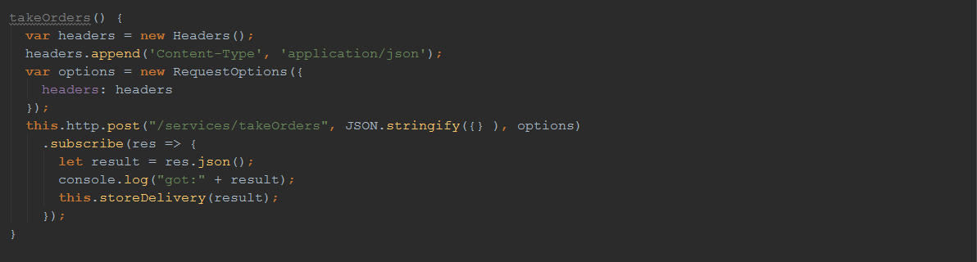
take Orders

Slide 9
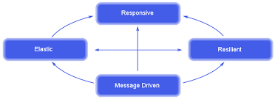
Ratpack
Ratpack is a set of Java libraries for building modern HTTP applications.
It is built on Java 8, Netty and Reactive principles.
Netty is a non-blocking I/O (NIO) client-server framework - Async
Reactive system:

Slide 10
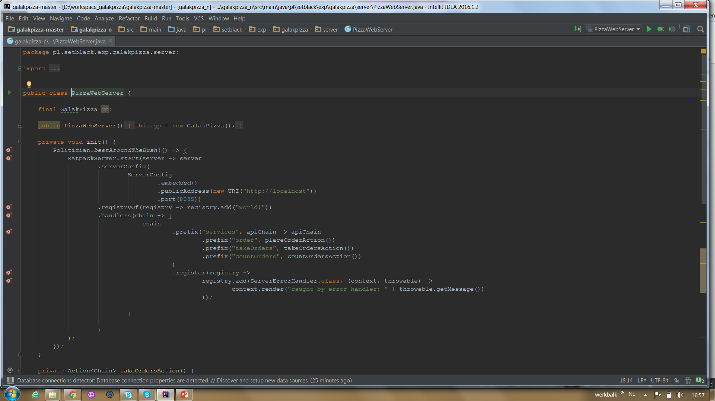
Ratpack

Slide 11
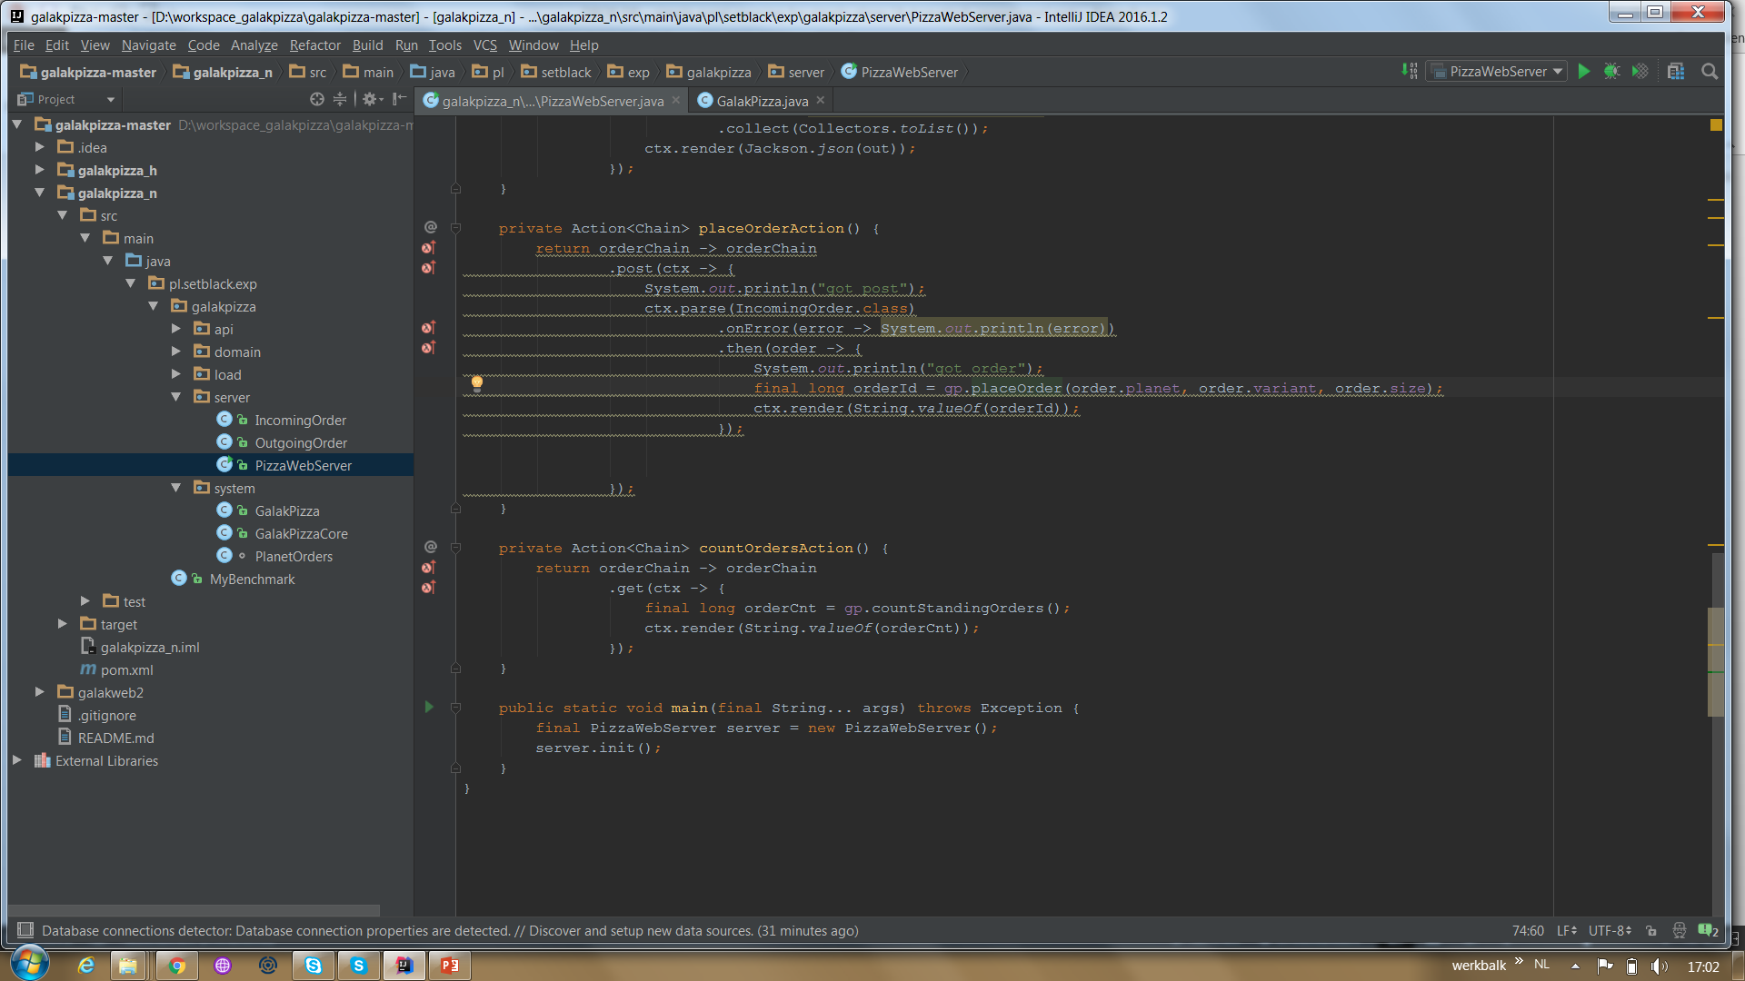
Ratpack

Slide 13
Prevayler / Airomem
Airomem is Java persistence framework based on Prevayler
Keep all business objects and state in RAM
No Database → only persistence
Event sourcing: representing objects as a sequence of events

Slide 14
What if there's a system crash?
snapshot of all business objects to a file using serialization
All commands received from the system's clients are serialized to a log file / journal.
During crash recovery:→ retrieve business objects from snapshot → read all commands → apply the commands to the business objects

Slide 15
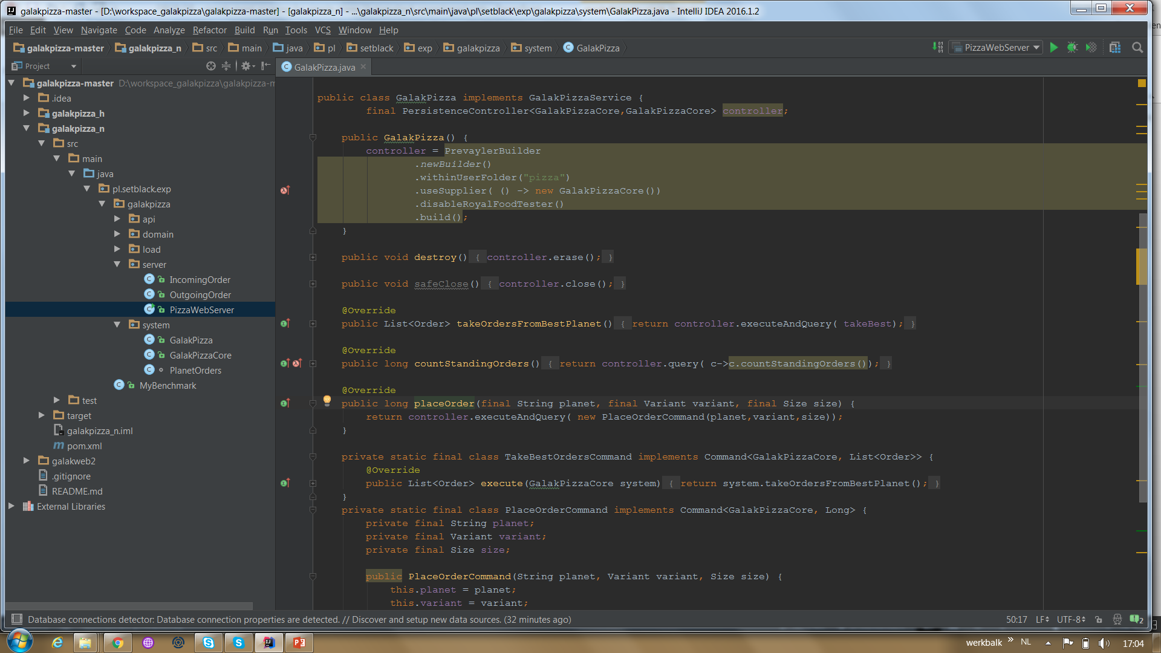
Prevayler

Slide 16
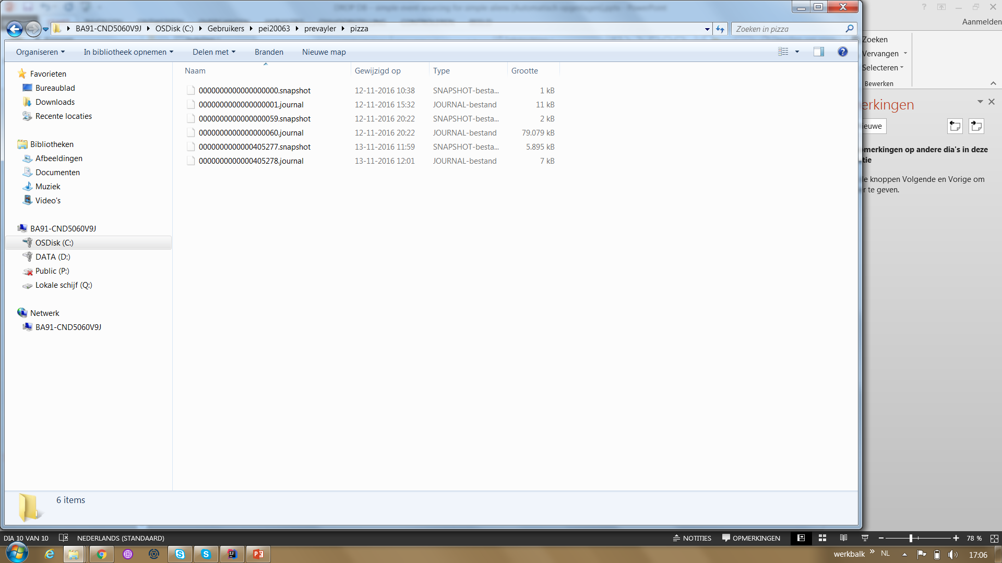
Journal with events

Slide 17
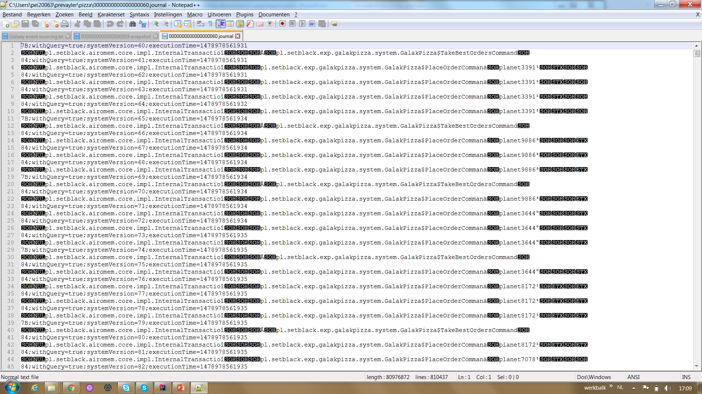
Events = commands

Slide 18
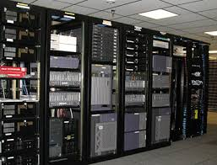

Difference
Prevayler / Airomem | ORM
+ Fast (1400 times) | -- Terrible slow
+ Code in Java | -- Code in String and Annotations
+ Strongly typed (Java 8) | -- Stringly typed
+ Flexible | -- Limited Domain
+ Testtable | -- Testing expensive
+ No Session/ no EntityManager, no SQL | -- Session, EntityManager, ORM, SQL

Slide 19
Prevayler
Commands/event are never executed concurrently
CQRS simplified → one command → one event
Use of RAM and CPU → very fast
Postpone decision which Database to use

